Slide 1
The Computer
a computer system is made up of various elements
each of these elements affects the interaction
  input devices - text entry and pointing
  output devices - screen, audio
  paper input and output
  memory - RAM, permanent storage media
  processing - speed of processing, networks

Slide 2
Introduction
The computer is the participant in the interaction that runs the program
• general phrase, encompassing many interactive devices - light switches, cars, etc.
• we shall consider mainly the electronic computer
There are two fundamentally different forms of interaction
• batch - usually when large quantities of data have to be read into the machine; requires little user intervention
• interactive - when the user controls things all the time
Concentrate on interactive use

Slide 3
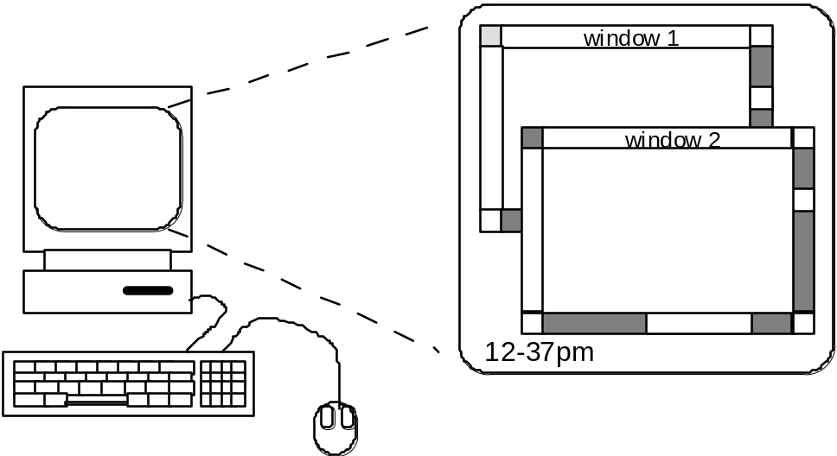
A typical computer system
• screen, or monitor, on which there are
• windows - separate areas that behave independently
• keyboard
• mouse
These devices dictate the styles of interaction that the system supports
If we use different devices, then the interface will support a different style of interaction

Slide 4
Keyboard
• Common input device
• Standardised layout (QWERTY) (although non-alphanumeric keys are placed differently, and there is a difference between key assignments on UK and USA keyboards)
QWERTY arrangement not optimal for typing - layout due to typewriters.
Other keyboard designs allow faster typing but large social base of QWERTY typists produces reluctance to change.
• Keypress closes connection, causing a character code to be sent
• Usually connected by an umbilical cord
• Allows rapid entry of text by experienced users

Slide 5
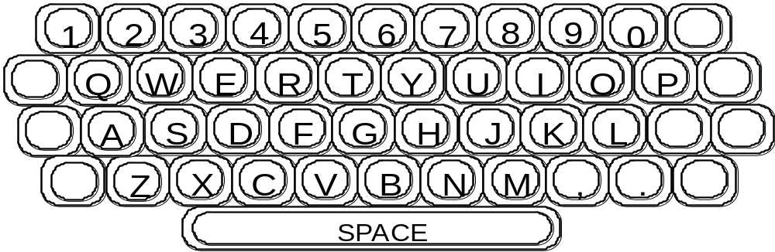
Keyboards cont

Slide 6
Other Keyboards
Alphabetic
Keys arranged in alphabetic order
• not faster for trained typists
• not faster for beginners either

Slide 7
Dvorak
• common letters under dominant fingers
• biased towards right hand
• common combinations of letters alternate between hands
• 10-15% improvement in speed and reduction in fatigue
• But - large social base of QWERTY typists produce market pressures not to change

Slide 8
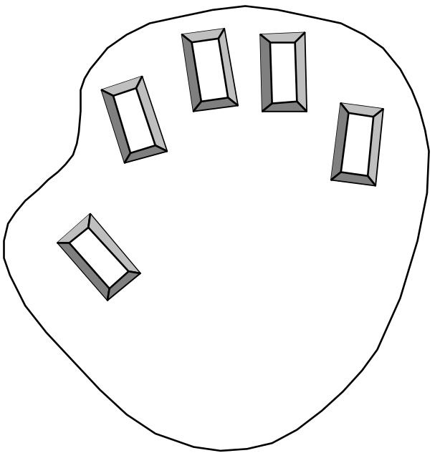
Chord keyboards
• only a few keys - four or 5
• letters typed as combination of keypresses
• compact size - ideal for portable applications
• short learning time - keypreses reflect shape of desired letter
• fast
• But - social resistance, plus fatigue after extended use

Slide 9
Other text entry devices
Handwriting recognition
Handwritten text can be input into the computer, using a pen and a digesting tablet
• common form of interaction
Problems in
• capturing all useful information - stroke path, pressure, etc. in a natural manner
• segmenting joined up writing into individual letters
• interpreting individual letters
• coping with different styles of handwriting
Handheld organisers being released now that incorporate handwriting recognition technology and do away with a bulky keyboard

Slide 10
Speech recognition
Promising, but only successful in limited situations - single user, limited vocabulary systems
Problems with
• external noise interfering
• imprecision of pronunciation

Slide 11
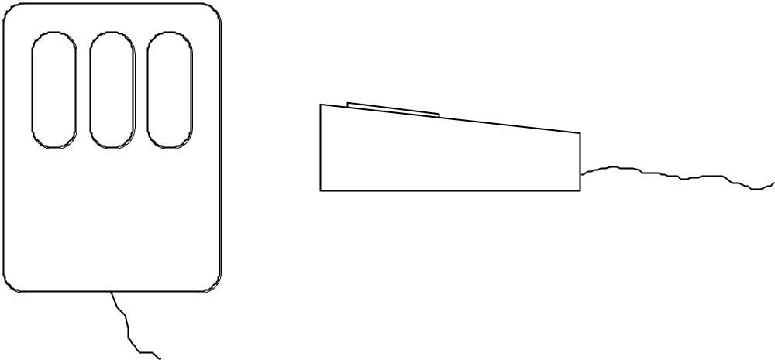
Positioning and Pointing Devices
Mouse Handheld pointing device
• very common
• easy to use
Two characteristics
• planar movement
• buttons (usually from 1 to 3 buttons on top, used for making a selection, indicating an option, or to initiate drawing etc.)

Slide 12
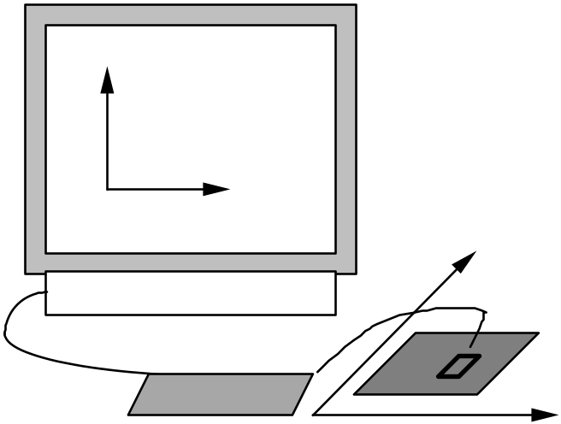
Mouse cont
Mouse located on desktop
• requires physical space
• no arm fatigue
Relative movement only is detectable.
Movement of mouse moves screen cursor
Screen cursor oriented in (x, y) plane, mouse movement in (x, z) plane:
an indirect manipulation device.
Device itself doesn’t obscure screen, is accurate and fast.
Can lead to hand-eye coordination problems due to indirectness of manipulation.

Slide 13
How does it work?
Two methods for detecting motion
Mechanical
Ball on underside of mouse turns as mouse is moved
Rotates orthogonal potentiometers
Can be used on almost any flat surface

Slide 14
Optical
light emitting diode on underside of mouse
sits on special gridlike pad on desk; less susceptible to dust and dirt
detects fluctuating alterations in reflected intensity as mouse is moved over the gridlines, used to calculate relative motion in (x, z) plane
Also a device known as the footmouse - operated with the feet; a rare device, not in common use

Slide 15
Other positioning devices
Joystick
Indirect device
Takes up very little space
Controlled by either
• movement (absolute joystick) - position of joystick corresponds to position of cursor
• pressure (isometric or velocity-controlled joystick) - pressure on stick corresponds to velocity of cursor
Usually provided with buttons (either on top or on front like a trigger) for selection
Does not obscure screen
Inexpensive (often used for computer games, also because they are more familiar to users)

Slide 16
Trackball
Bit like an upside-down mouse. Ball is rotated inside static housing, relative motion moves cursor. Indirect device, fairly accurate. Requires buttons for picking. Size and “feel” of trackball itself important. Requires little space, becoming popular for portable and notebook computers.

Slide 17
Touch-sensitive screen (touchscreens)
Detect the presence of finger or stylus on the screen. Work by interrupting matrix of light beams or by capacitance changes or ultrasonic reflections. Direct pointing devices.
Advantages: Fast, and require no specialised pointer. Good for menu selection. Suitable for use in hostile environment: clean and safe from damage.
Disadvantages: Finger can mark screen. Imprecise (finger is a fairly blunt instrument!) - difficult to select small regions or perform accurate drawing. Lifting arm can be tiring, and can make screen too close for easy viewing.

Slide 18
Light pen
Coiled cable connects pen to c.r.t. In operation, pen held to screen and detects burst of light from screen phosphor during display scan.
Direct pointing device: accurate (can address individual pixels), so can be used for fine selection and drawing.
Problems: pen can obscure display, is fragile, can be lost on a busy desk, tiring on the arm.
Both much less popular than the mouse

Slide 19
Digesting tablet
Indirect device.
Resistive tablet detects point contact between 2 separated sheets: has advantages in that it can be operated without specialised stylus - a pen or the user’s finger is fine.
Magnetic tablet detects current pulses in magnetic field using small loop coil housed in special pen.
Also capacitive and electrostatic tablets.
Sonic tablet similar to above but requires no special surface: ultrasonic pulse emitted by pen detected by two or more microphones which then triangulate the pen position. Can be adapted to provide 3-d input.
High resolution, available in a range of sizes from A5 to 60x60 in. Sampling rate between 50 and 200 Hz. Can be used to detect relative motion or absolute motion. Can also be used for text input (if supported by character recognition software). Require large amount of desk space, and may be awkward to use if displaced by the keyboard.

Slide 20
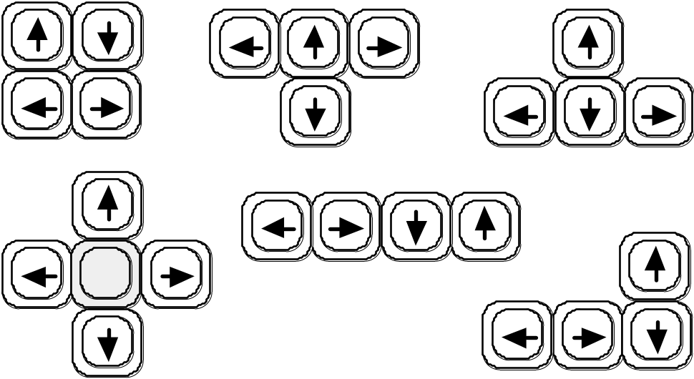
Cursor keys
Four keys (up, down, left, right) on keyboard. Very, very cheap, but slow. Useful for not much more than basic motion for text-editing tasks. No standardised layout: line, square, “T” or inverted “T”, or diamond shapes are common.

Slide 21
Thumb wheels
Two orthogonal dials to control cursor position. Cheap, but slow.
Keymouse
Single key, acts like isometric joystick. Small, compact, but very little feedback and unknown reliability.

Slide 22
Dataglove
Lycra glove with optical fibre sensors. Detects joint angles and 3-d hand position.
Solution in search of a problem - the technology to utilise the power of this form of input properly does not exist yet.
Advantages: easy to use, potentially powerful and expressive (10 joint angles + 3-d. spatial information, at 50 Hz.).
Disadvantages: difficult to use with a keyboard, expensive (~£10k/glove).
Potential: vast - gesture recognition, sign language interpretation, etc.
Eyegaze
Headset detects user’s eye movements to control cursor. Very fast and accurate, also expensive.

Slide 23
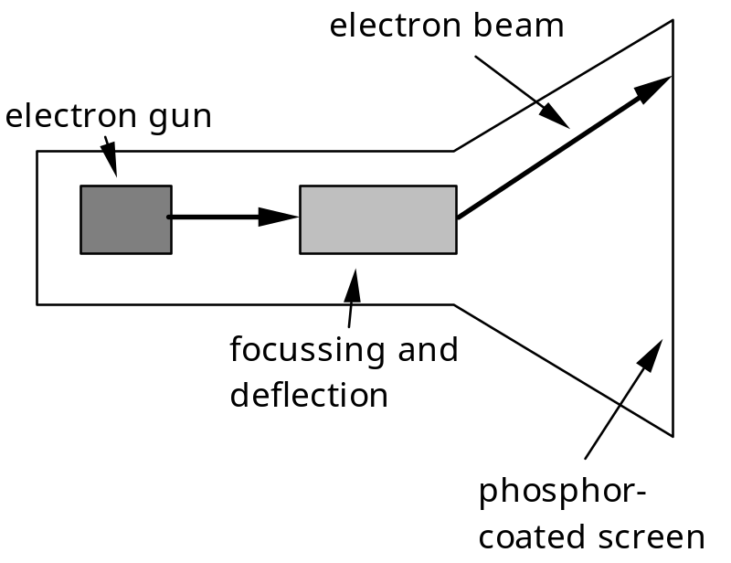
Output devices
One predominant - the computer screen, usually the cathode ray tube
Cathode ray tube
Stream of electrons emitted from electron gun, focused and directed by magnetic fields, hit phosphor-coated screen which glows.
Three types: raster scan, random scan, and direct view

Slide 24
Raster scan
Most common, as found in televisions.
Beam scanned left to right, flicked back to rescan, from top to bottom, then repeated. Repeated at 30Hz per frame, sometimes higher to reduce flicker. Interlacing, scanning odd lines in whole screen then even lines, is also used to reduce flicker. Can also use high-persistence phosphor to reduce flicker but causes image smearing especially with significant animation.
Resolution typically 512x512, but high-quality screens are available (and becoming more common) at up to approximately 1600x1200 pixels. Sun workstations have screens of 1192x980 pixels.
Black & white screens can display grayscale by varying the intensity of the electron beam.

Slide 25
Raster scan cont
Colour is achieved using three electron guns which hit red, green or blue phosphors. Combining these colours can produce many others, including white (all on). Phosphor dots focused using a shadow mask - makes colour screens lower resolution than monochrome.
Alternative approach: beam penetration. Special phosphor glows a different colour depending on intensity of beam.
Colour or intensity at pixel held by computer’s video card. 1 bit/pixel can store off/on information, hence only black&white. More bits/pixel give rise to more colour possibilities, e.g.. 8 bits/pixel gives rise to 2^8=256 possible colours at any one time.

Slide 26
Random Scan (Directed-beam refresh, vector display)
Instead of scanning the whole display sequentially and horizontally, the random scan draws the lines to be displayed directly. Screen update at >30Hz to reduce flicker. Jaggies not found, and higher resolutions possible (up to 4096x4096 pixels). Colour achieved using beam penetration, generally of poorer quality. Eye strain and fatigue still a problem, and vector displays are more expensive.
Direct view storage tube (DVST)
Used a lot in analogue storage oscilloscopes.
Similar to random scan c.r.t. but image maintained by flood guns - no flicker. Can be incrementally updated but not selectively erased; image has to be redrawn on completely erased screen. High resolution (typically 4096x3120 pixels), but low contrast, low brightness and difficulty in displaying colour.

Slide 27
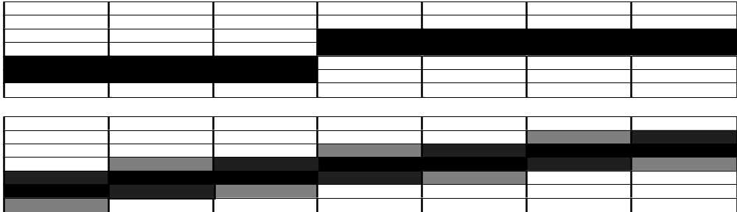
Cathode Ray Tube
Advantages of c.r.t.: cheap, fast enough for rapid animation, high colour capability. Increased resolution produces higher prices.
Disadvantages: bulky - due to electron gun and focusing components behind screen. Problems with “jaggies”, diagonal lines that have discontinuities in due to horizontal raster scan process.
Reduced by using high-resolution screens, or by anti-aliasing, which softens edges of line segments. Flicker, poor legibility and low contrast can also cause eyestrain and fatigue.

Slide 28
Concerns regarding emissions of radiation:
• X-rays: largely absorbed by screen (but not at rear!)
• UV- and IR-radiation from phosphors: insignificant levels
• Radio frequency emissions, plus ultrasound (~16kHz)
• Electrostatic field - leaks out through tube to user. Intensity dependant on distance and humidity. Can cause rashes.
• Electromagnetic fields (50Hz-0.5MHz). Create induction currents in conductive materials, including the human body. Two types of effects attributed to this: visual system - high incidence of cataracts in VDU operators, and concern over reproductive disorders (miscarriages and birth defects).
• Take extra care if pregnant.

Slide 29
Hints, advantageous to your health:
• do not sit too close to the screen
• do not use very small fonts
• do not look at the screen for long periods without a break
• do not place the screen directly in front of a bright window
• work in well-lit surroundings

Slide 30
Liquid crystal displays
Smaller, lighter, with no radiation problems. Matrix addressable. Found on portables and notebooks, and starting to appear more and more on desktops.
Similar in principle to that found in the digital watch. Thin layer of liquid crystal sandwiched between 2 glass plates. Top plate transparent and polarised, bottom plate reflecting. External light passes through top plate and crystal, and reflects back to eye. When voltage applied to crystal (via the conducting glass plates) it changes its polarisation, rotating the incoming light so that it cannot reflect back to the eye. LCD requires refreshing at usual rates, but slow response of crystal means flicker not usually noticeable. Colour possible.
Less tiring than c.r.t. displays, and reduce eye-strain, due to reflected nature of light rather than emitted. Use of super-twisted crystals have improved the viewing angle, and response rates are improving all the time (necessary for tracking cursor accurately).

Slide 31
Alternative Output Devices
Visual
• analogue representations: dials, gauges, lights, etc
.
• head-up displays - found in aircraft cockpits
Auditory
• beeps, bongs, clonks, whistles and whirrs
• used for error indications
• confirmation of actions e.g. keyclick
• speech: not a fully exploited area

Slide 32
Printing
Popular printing technology builds up characters on page, as on the screen, as a series of dots. Allows any character set or graphic to be printed, depending on the resolution of the dots, measured in dots per inch (dpi).
• dot-matrix printers use inked ribbon, with a line of pins that can strike the ribbon, dotting the paper. Typical resolution 80-120 dpi. May have many lines in parallel, making a matrix of pins
• ink-jet and bubble-jet printers tiny blobs of ink sent from print head to paper: ink-jet squirts them, bubble-jet uses heat to create bubble. Quiet. Typically at 300 dpi or better .

Slide 33
Printing cont
• thermal printers use heat-sensitive paper that alters colour when heated. Paper heated by pins where a dot is required. Usually only one line of dots created per pass. Poor quality, but simple - fax machines are most common example
• laser printer like photocopier; dots of electrostatic charge deposited on drum, which picks up toner (black powder form of ink), rolled onto paper which is then fixed with heat. Typically 600dpi or better.

Slide 34
Fonts
Font refers to the particular style of text. Typical fonts are
Courier font
Helvetica font
Palatino font
Times Roman font
♣×∝≡↵ℜ€⊗↵∼€ (special symbol)
The size of a font is measured in points (pt), about 1/72”, and is related to its height.
This is ten point Helvetica
This is twelve point
This is fourteen point
This is eighteen point
and this is twenty-four point

Slide 35
Fonts cont
There are other characteristics of fonts apart from their size:
Pitch
• fixed-pitch , with each character having the same width (for example, Courier)
• variable-pitched , when some characters are wider than others (for example, Times Roman - compare the ‘i’ and the “m”)
Serif or Sans-serif
• sans-serif , i.e. with square-ended strokes (like Helvetica), or
• serif , with splayed ends (such as Times Roman or Palatino)

Slide 36
Page Description Languages
Pages can be very complex, with text in different fonts, bitmaps, line illustrations, digitised photographs, etc.
Can be produced by converting all the information into a bitmap and sending that to the printer, but this is often a huge file.
Alternatively, a complete description of the page can be sent, specifying how to draw the graphics and write the text in the desired fonts.
This approach uses a page description language : a programming language for printing.
Contains instructions for drawing curves, lines, text in different styles, scaling information and so on.
PostScript is the most common

Slide 37
Scanners and Optical Character Recognition
Scanners take paper and convert it into a bitmap
Two sorts of scanner
• flat-bed: paper placed on a glass plate, whole page converted into bitmap
• hand-held: scanner passed over paper, digitising strip typically 3-4” wide
Can work in colour: shine light at paper and note intensity of reflection.
Resolutions from 300-600 dpi, but available up to 4800 dpi.
Also special scanners for slides and photographic negatives

Slide 38
Scanners cont
Used in
• desktop publishing for incorporating photographs and other images
• used in document storage and retrieval systems,
doing away with paper storage
Optical character recognition (OCR) converts bitmap back into text
• different fonts create problems for simple “template matching”
algorithms
• more complex systems segment text, decompose it into lines
and arcs, and decipher characters that way

Slide 39
Short-term Memory - RAM
Random access memory (RAM)
• on silicon chips
• 100 nano-second access time
• usually volatile (lose information if power turned off)
• data transferred at around 10 Mbytes/sec
Some non-volatile RAM used to store basic set-up information
Typical desktop computers: 16 to 128 Mbytes RAM

Slide 40
Long-term Memory - disks
• magnetic disks
- floppy disks store around 1.4 Mbytes
- hard disks typically 5 Gbytes or larger
access time ~10ms, transfer rate 100kbytes/s
• optical disks - use lasers to read and sometimes write
- more robust that magnetic media
• CD-ROM - read-only
- same technology as home audio, ~ 600 Gbytes
• WORM - write once read many - good for backups
• rewritable CDs - more expensive
• DVD - for AV applications

Slide 41
Virtual Memory
Problem:
running lost of programs + each program large
⇒ not enough RAM
Solution - Virtual memory :
store some programs temporarily on disk
makes RAM appear bigger
But … swopping
program on disk needs to run again
copied form disk to RAM
s l o w s t h i n g s d o w n

Slide 42
Storage formats - text
• ASCII - 7-bit binary code for to each letter and character
• UTF-8 - 8-bit encoding of 16 bit character set
• RTF (rich text format)
- text plus formatting and layout information
• SGML (standardized generalised markup language)
- documents regarded as structured objects
• XML (extended markup language)
- simpler version of SGML for web applications

Slide 43
Storage formats - media
Images:
• many storage formats :
(PostScript, GIFF, JPEG, TIFF, PICT, etc.)
• plus different compression techniques
(to reduce their storage requirements)
Audio/Video
• again lots of formats :
(QuickTime, MPEG, WAV, etc.)
• compression even more important
• also ‘streaming’ formats for network delivery

Slide 44
Processor Speed
Designers tend to assume infinitely fast processors, and make interfaces more and more complicated
But problems occur, because processing cannot keep up with all the tasks it needs to do
• overshooting because system has buffered keypresses
• icon wars - user clicks on icon, nothing happens, clicks on another, then system responds and windows fly everywhere
Also problems if system is too fast - e.g. help screens may scroll through text much too rapidly to be read

Slide 45
Limits on Interactive Performance
Computation bound
Computation takes ages, causing frustration for the user
Storage channel bound
Bottleneck in transference of data from disk to memory
Graphics bound
Common bottleneck: updating displays requires a lot of effort - sometimes helped by adding a graphics co-processor optimised to take on the burden
Network capacity
Many computers networked - shared resources and files, access to printers etc. - but interactive performance can be reduced by slow network speed

